Slide 1
One way for python application to launch on web server Apache is to use mod_wsgi utility which is complaint with WSGI so that python application can be launched on apache server
Python application
Mod_wsgi/wsgi compliant / werkzeug library
Apache web server
Other option is use python web framework like Flask , Djando that are shipped with WSGI module so that no need to use mod_Wsgi module.
Web framework with WSGI
Python application

Slide 2
Video Tutorials at
https://www.youtube.com/watch?v=GJrS5ckgjAs&index=4&list=PLEbnTDJUr_IegfoqO4iPnPYQui46QqT0j

Slide 3
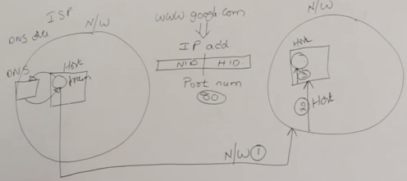

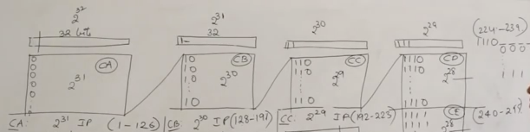
Why we need IP address to connect to google.com AND ISP provider resolves DNS names to IP address before google network is contacted
HOW WE DIVIDE NETWORK ID INTO 4 CLASSES WITH DIFFERENT BITS . WE TYPICALLY USE 192-225 RANGE.
LBA – Limited broadcast address which is 255.255.255.255 WHICH IS RESERVED

Slide 4
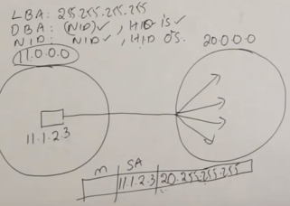
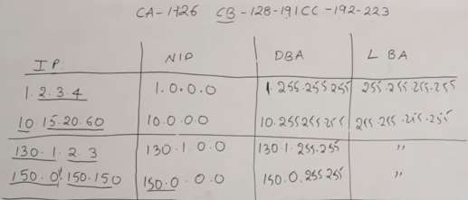
Directed broadcast address – As shown below. Left side network host is trying to send packet to hosts in other network. Second network has network id 20.0.0.0 and leftside network belong to 11.0.0.0
Now when message goes from left to right, only network id is retained and rest all 24 bits or all host id 0’s are replaced with 1’s (which is 255:255:255) . In rectangle package below, m means message, SA – source address and next column is DA destination address.
As shown to figure next , Class A, B, C network ids are shown. As bits move into CA/CB/CC range then next bit becomes part of network id. Example. 1 example 1.2.3.4 has 1 (1st bit belong to CA ) so NID (network id) – 1 and rest all bits are host id. Whereas 3rd & 4th example 150.0.150.150 belongs to CB so 1st and 2nd bit belongs to NID which is 130.1 and 150.0 and test all bits goes to HOST ID. DBA and LBA is direct/limited broadcast address

Slide 5

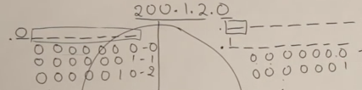
Subnet and subnet mast concepts
Network
Example if network 200.1.2.0 id divided into two sections as shown in circle, then we are dividing network into two mini networks which is called subnets. Now subnet division takes 1 bit (shown as SID in figure below) to identify subnet id(mini network id) with in entire network and remaining bits of that 8 bits goes to host id.
subnet
host
Process/port
As shown below, first bit of left portion of circle is 0 and right portion of circle is 1. therefore it is now considered as subnet id bit and rest remains host id bits

Slide 6
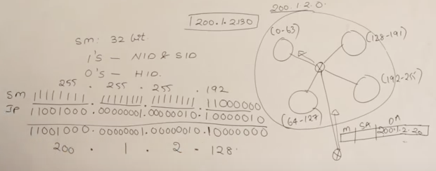
Subnet Mask , also called as Network mask
Subnet mask is like MAC address that helps to route incoming traffic (traffic looking to connect to specific ip in our network) to appropriate mini network or subnet . Subnet mask helps to identify which subnet id should be directed to satisfy incoming traffic.
In example below, lets say we have divided our network into 4 subnets. So we took 2 bits of last 8 bits of host id dedicated to subnet id to do such division. So 2 bits gets us 4 parts of whole circle. Now those 2 bits taken by subnet are always represented by 1s. Router is at the middle which will direct traffic to correct subnet id with the help of subnet mask
In order to derive correct mini network within 4 sections , we need to take subnet mask and “and” it with incoming IP address of traffic and then get to new network id which is our mini network id. Rule of “and” operation is 1 + 0 = 0 and 1 + 1 = 1. So in example above, we get incoming ip as 200.1.2.130 which is “and” to subnet mask ( SM) and then we get 200.1.2.128 which is our next subnet id within whole network or circle. So now router know incoming traffic should be set to small circle or subnetid 128-191 because newly derived mini network ends with 128 ( 200.1.2.128)

Slide 7
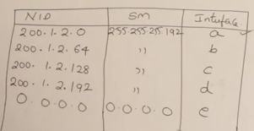
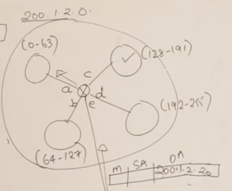
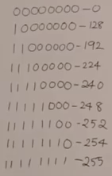
Routing tables – In slide above 4. routing table will show relationship between NID , Subnet mask and interface
If incoming traffic’s ip doesnot fall under any of the mini NID that is derived after doing calculation using subnet mask then packet is sent back via interface e and it has 0.0.0.0 as network id.

Slide 8
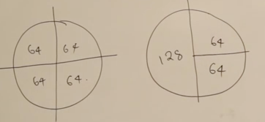
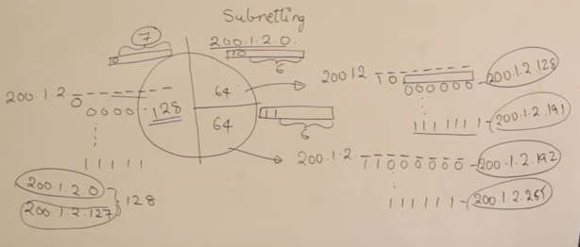
Variable length subnet masking – Means whole network is broken into un-even size of mini network as shown in example below
As shown in ex. Right circle network is broken into 3 mini network so calculation of subnet id or mini network can be as shown below. Last 8 bit is now host id but 1 bit is offered for subnet for left portion 128 section of the circle and 2 bits of that 8 bits are given to subnet to use 0 and 1 for 64 section of the circle.
1s always represents network id and subnet id part whereas 0s always represent bits used by host id
Subnet for this mini network
255.255.255.128
11111111.11111111.11111111.10000000
Subnet for this mini network
255.255.255.192
11111111.11111111.11111111.11000000

Slide 9

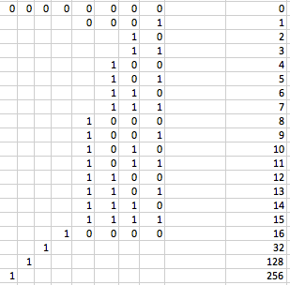
Routing table for example on previous slide may look like as below

Slide 10
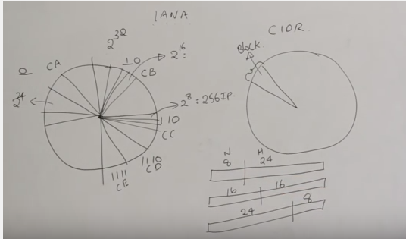
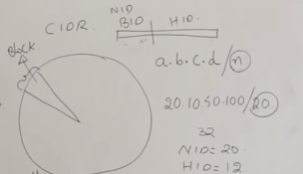
Instead of using classes for classify network, its is now using something called CIDR block. So when someone request range of IP address for setting up their network to IANA authority , they get block called CIDR block. So this block can fall in any class if we see below
In case of CIDR , network id is also called BLOCK id. So confusion is how many bits out of 32 is block id and how many host id . To eliminate that confusion, CIDR typically specify bits after / . Example shown below, 10 bits for block id. So out of total 32 bits, 10 bits are reserved for block id so remaining 12 are given to host id. So in the host
we can have 2^12 ip addresses =

Slide 11
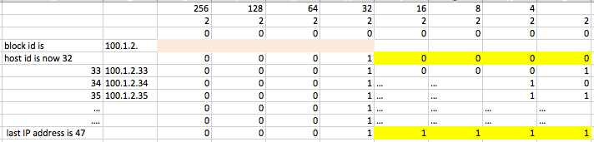
Finding the block of IP address from given CIDR block – example below
Given – 100.1.2.35/28
Which is 100.1.00000010
Solution to find block of Ips –
Block id = 35
Size of network or subnet id = 28
So total bits for hosts = 32 – 28 = 4 is host ids
100.1. 1→ This becomes 24 bits out of 32 bits
Last bit of 8 needs to be now adjusted
00 00 00 00
First 00 00 is gone to network id and remaining 00 00 is for host id . Now that we have given 35, it can represent 00 10 00 11 as shown below. So actual range of host ips can start from 32 , include 35 as one of the block( given as a requirement block )and end up 47 as last ip .

Slide 12
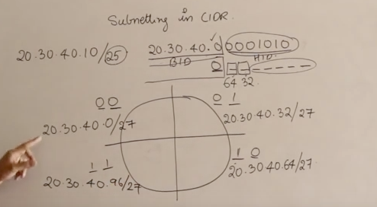

Subnetting in CIDR
In this example, we have divided entire network into 4 subnets . Now we have given 20.30.40.10/25 Which means we have taken 1 bit of last section to form 25 so we now have 20.30.40.0 into block id section and remaining bits (7 of last section) as host id which includes 10 so it will begin with 0000000 and include end with 1111111
Now lets divide this circle into 4 pieces. And 2 bits of remaining 7 is now gone for subnetting. So we left with 5 bits. Since we added 2 bits from host id section to subnetting , it will be considered as block id therefore block size now becomes 25+2 = 27 .

Slide 13
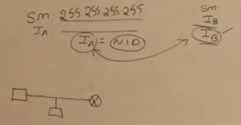
Internet service provider ISP gives following things by default
IPV4
Default gateway – is a router connected to network
Subnet mask
DNS
For the security reason, every host should send packet to router and router should send that packet to destination. This is possible only if subnet mask is set correctly.
As example below, if we “and” subnet mask and IP of A (host) then it will result in same number as a network id since subnet mask last bits are 255 (which will give and result same as ip bits) . Same happens with another host B try to send packet to A .. Therefore resulted network id from A and B are different so it goes to router always before router find the destination of the packet even though A and B may be in the same network . It is not secured for A or B to connect directly, it is safe to send packet to router first.

Slide 14
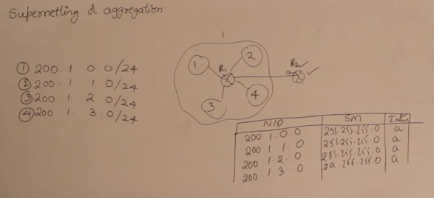
As shown in example below, if external router needs to contact or send packet to any of the four hosts then it will require its router table with four entries. Instead , it can just send packet to internal router and let internal router send packet to host. So let internal router maintain 4 entries
In order to create a supernet id for above case, eligibility is
All four network id should have continuous numbers 0, 1, 2, 3 etc
All should have same size which is 24
Sum of all should be divisible by 2 which is 4 * 2^ 8 = 2^10
Therefore we can form a supernet id of above case. First we need to find supernet mask and then supernet id and then update routing table at router R2.
For supernet mask , we have to put all 1s in fixed part and 0s in all variable part. (which is opposite of subnet mask) ..see next page

Slide 15
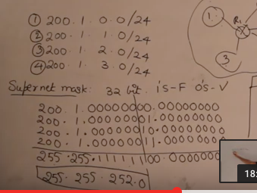

As shown below, upto 6th bits of 3rd section everything is fixed. After that everything is variables part. So we put all 1s upto 6th bits in binary (all 1s) . Since 200.1. is common which is 255.255 for all ones in bits. And then remaining 6 bits are 1s so we put 1s there and then remaining bits we put all 0s. So supernet mask is 255.255.252.0
Supernet id – Now we know supernet mask , we need to find suprnet id , we can take 255.255.252.0 and “and” it with any of the 4 ip address, we will get supernet id. Example “and” 255.255.252.0 with 200.1.1.0 we will get 200.1.1.0
Or take 255.255.252.0 and “and” with 200.1.3.0 we will get 200.1.1. 0 Typically first network id is considered as supernet id which is in this case 200.1.0.0 . So router R2 will now have only 1 entry in its routing table as follows to represent entire network of 4 ips.

Slide 16
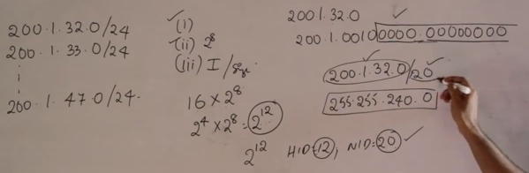
Shortcut to find supernet mask and supernet id . In example below, supernet id is 200.1.32.0 since its first network id in the pool
Supernet mask is 255.255.240.0 which is represented by /20 .
To get supernet mask , we need to follow process shown in previous slide. There is shortcut to get that as follows -
16 * 2^8 – How did we get this ?
How many network id we have from 32 till 47 = 16 network ids(not 15 , count it) .
Power of each network id is 2^8 ( which is /24)
So now total pool is 16 * 2^8 = 2^ 4 * 2^8 = 2^ 12
So now host id part is 12 and remaining 32 – 12 = 20 is the supernet id part.
So we put /20 to supernet id and supernet mask becomes 255.255.240.0

Slide 17
AS-IS Aexp architecture
CGW-148.173.97.208
AT-52.11.194.54
VPN - PROD_SEC_VPN_AEXP
Static Ips(15)
Prod_SEC_VPN_GW
VPC-172.24.224.0/24
Route TableIP(15)
Network ACL-acl-127fd176
Route TableIP(15)
Route Propagation-VGW-af845db1
SG-Private
PT-52.35.187.190
SG-Private
IB/OB
IGW-57300432
VPN - PROD_TENANT_MBaaS_VPN_AEXP
VGW-cdb56cd3
AWS-ISOLOGV01
AT-52.26.85.219
VPC-172.24.225.0/24
PROD_SEC_NGINX Interface
Static IPs
AT-52.32.50.245
PROD_SEC_PA-MGT-Interface
PROD_TENANT_MBaaS_VPN_GW
Prod_AExp
AT-52.37.139.252
AT-52.38.36.240
CGW-52.38.251.187
Local and 0.0.0./0
Network ACL-acl-dbf547bf
Local and 0.0.0./0
CGW-52.36.136.130
SG-Private
172.24.224.9
SG-Private
Prod_ISP
VPN - PROD_TENANT_MBaaS_VPN_ISP
IB/OB
172.24.224.9
IGW-57300432

Slide 18
Normal connections between Public and Private subnets and connecting private to internet using Public subnet
VPC – 10.0.0.0/16
US east-2 zone
US West zone
EC2 instances stay here
Subnet 10.0.2.0/24
Subnet 10.0.3.0/24
ELB or Elastic IP address
Route
Allow 10.0.3.0 INBOUND
IGW
www
NATSGrp
2. Create NATSG
in Public subnet
Public Resource
Private Resource
1.
Log into EC2 of 10.0.2.0 and then do SSH to 10.0.3.0 to connect since all subnet within same VPC are connected. But 10.0.3.0 cannot be connected directly from internet or terminal. Once inside , we can ping yahoo.com without having to put 10.0.3.0 on IGW or Elastic IP assignment – This is typically used for patch updates from internet to private instances however without NAT GW , patch update (yum update) maynot possible so create NAT security group and allow private subnet request for update from internet
EC2 from subnet can talk to internet even with IGW is attached is only by having ELB or elastic IP address assignment to that subnet.

Slide 19
Get Patch updates to private subnet using NAT
VPC – 10.0.0.0/16
Private Resource
US West zone
Subnet 10.0.3.0/24
Route table allow 0.0.0.0 with NAT instance assigned and allowed to subnet 10.0.3.0
Download updates
Public Resource
Allow 10.0.3.0 INBOUND
Elastic IP + IGW
US east-2 zone
Subnet 10.0.2.0/24
NAT Community AMI
NAT Instance
NATSGrp
NAT Disable check(right click)
Elastic IP
1.

Slide 20
Load Balancer ; ASG
VPC – 10.0.0.0/24
Web servers
RDS Databases
Route53-DNS/Config
US east-1 zone
US east-2 zone
US east-1 zone
US east-2 zone
Public Subnet 10.0.0.0/24
Public Subnet 10.0.1.0/24
Private Subnet 10.0.3.0/24
Private Subnet 10.0.4.0/24
Route + IGW
DB Subnet group
EC2 Instance
EC2 Instance
RDS Instance
App. Security group
Security group
All traffic from App security grp allowed
1. Inbound and 2. Outbound as well.
Instance Web traffic
ELB
Public Subnet 10.0.0.0/24
Public Subnet 10.0.1.0/24
Design ASG launch configuration – Information about AMI/instance
Design ASG group and assign ELB here.
Upon completion of ASG group, it will launch instance and associate that with ELB automatically

Slide 21
Network ACL is at securing subnet level
Security group is securing EC2 instances
Elastic ip address can be attached to Network interfaces so that when instance is stopped , it doesnot loose it ‘s elastic ip address due to network interface assignment . – Good practice
NAT instances are always in public subnet which will route traffic to private subnet resources.

